Slide 1
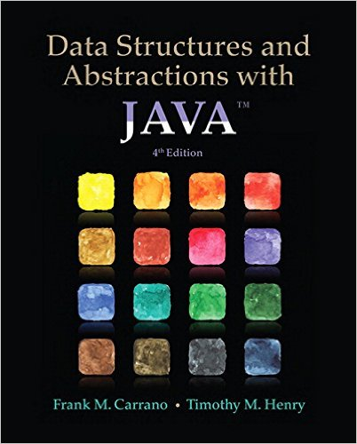
Lecture 11
Chapter 19: Dictionaries
Chapter 20: Dictionary Implementations

Slide 2
In CI Learn click on:
“Lecture 11 - Dictionaries”
and download LectureDictionary.zip

Slide 3
Objectives
Describe operations of ADT dictionary
Distinguish between a dictionary and a list
Use a dictionary in a program

Slide 4
Iterators and java 8
private void displayTheNumbers()
{
if(this.theNumbers.isEmpty())
System.out.println("The list is empty.");
else
{
Iterator<Integer> iter = this.theNumbers.iterator();
while (iter.hasNext())
System.out.print(iter.next() + " ");
}
System.out.println();
}
private void displayTheNumbers()
{
if(this.theNumbers.isEmpty())
System.out.println("The list is empty.");
else
{
this.theNumbers.forEach(item -> System.out.print(item + " "));
}
System.out.println();
}
since java 8

Slide 5
Contents
Specifications for the ADT Dictionary
  A Java Interface
  Iterators
Using the ADT Dictionary:
  A Problem Solved: A Directory of Telephone Numbers
  A Problem Solved: The Frequency of Words
  A Problem Solved: A Concordance of Words
Java Class Library: The Interface Map

Slide 6
Specifications ADT Dictionary
Synonyms for Dictionary
  Map
  Table
Contains
  Search key
  Value

Slide 7

Figure 19-1 An English dictionary

Slide 8
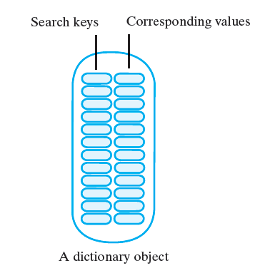
Figure 19-2 An instance of an ADT dictionary has search keys paired with corresponding values

Slide 9
Dictionary Operations
Add new entry, given search key and associated value
Remove an entry, given associated search key
Retrieve value associated with given search key
See whether dictionary contains a given search key
Traverse all search keys in dictionary
Traverse all values in dictionary
Detect whether dictionary is empty
Get number of entries in dictionary
Remove all entries from dictionary

Slide 10
Abstract Data Type: Dictionary
Operations
add(key, value)
remove(key)
getValue(key)
contains(key)
getKeyIterator()
getValueIterator()
isEmpty()
getSize()
clear()

Slide 11
Refining the Specifications
Distinct search keys
  Method add must deal with finding a duplicate search key
Duplicate search keys
  Methods remove and getValue must deal with the duplicates

Slide 12
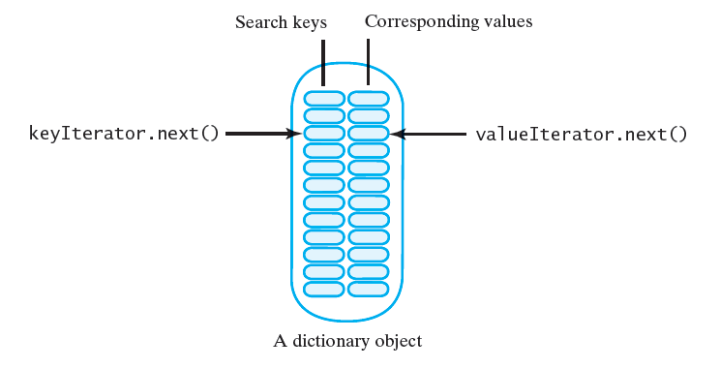
A Java Interface
Listing 19-1 contains a Java interface for the ADT dictionary
Iterators specified allow traversal of …
  All search keys in dictionary without traversing values
  All values without traversing search keys
  All search keys and all values in parallel

Slide 13
Dictionary – ex1
If the class Dictionary implements DictionaryInterface, write a Java statement that creates an empty dictionary myDictionary. This dictionary will contain the names and telephone numbers of your friends. Assume that names are the search keys. Let each phone number be a String.
DictionaryInterface<String, String> myDictionary = new Dictionary<String, String>();
Write a Java statement that adds your name and telephone number to this dictionary.
myDictionary.add(“Joe Java”, “555-1234”);

Slide 14

Dictionary – ex1
Display either John’s phone number or an error if he is not in the dictionary
String john = “John Java”;
if (myDictionary.contains(john))
System.out.print(john + “ phone number is “ + myDictionary.getValue(john));
else
System.out.print(john + “ is not in the dictionary”);
Or
String john = “John Java”;
String phoneNumber = myDictionary.getValue(john);
if (phoneNumber == null)
System.out.print(john + “ is not in the dictionary”);
else
System.out.print(john + “ phone number is “ + phoneNumber);

Slide 15
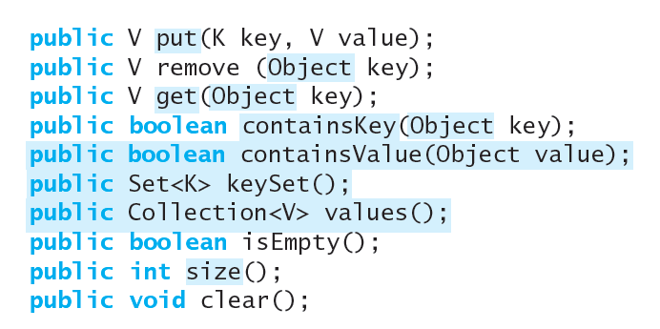
Java Class Library: The Interface Map
Package java.util contains interface Map<K,V>
  Similar to our ADT dictionary
Some implementing classes:
    TreeMap
      Guaranties that the map will be in ascending key order
    HashMap, Hashtable
      Make no guaranties as to the order of the map
View textbook examples modified to use java.util.* classes

Slide 16
A Directory of Telephone Numbers
Consider how client will use the class
Assume distinct search keys
  View class TelephoneDirectory

Slide 17
Directories – ex2
Implement a method for the class TelephoneDirectory.java that changes a person’s telephone number. Given the person’s name, the method should return either the person’s old telephone number or null if the person was not in the directory but has been added to it.
public String changePhoneNumber(String personName,
String phoneNumber)
{
return phoneBook.put(personName, phoneNumber);
}

Slide 18
The Frequency of Words
A class to count each occurrence of a word as a document is read
  Will read the input text from a file
  Results will be displayed as output
  For example, if the text file contains:
  row, row, row your boat
    The frequency would be:
    boat 1
    row 3
    your 1
View class FrequencyCounter

Slide 19
Example: A Concordance of Words
A concordance provides the line numbers that contain a particular word.
  For example, suppose that a text file contains only these lines:
I would rather be a 'could be' if I cannot be an 'are',
because a could be is a maybe who is reaching for a star.
I would rather be a 'has been' than a 'might-have-been' by far;
for a might-have-been has never been,
but a 'has' was once an are.
The following concordance of all the words in the file indicates the line numbers in which the words occur:
a 1 2 2 2 3 3 4 5
an 1 5
are 1 5
be 1 1 1 2 3
because 2
been 3 3 4 4
but 5
by 3
cannot 1
could 1 2
far 3
for 2 4
has 3 4 5
have 3 4
i 1 1 3
if 1
is 2 2
maybe 2
might 3 4
never 4
once 5
rather 1 3
reaching 2
star 2
than 3
was 5
who 2
would 1 3

Slide 20
A Concordance of Words
Read text from a file
  List each word
  Indicate line numbers in which word occurs
View class Concordance
  Note similarities to class FrequencyCounter

Slide 21
Dictionary Implementations

Slide 22
Contents
Array-Based Implementations
  An Unsorted Array-Based Dictionary
  A Sorted Array-Based Dictionary
Linked Implementations
  An Unsorted Linked Dictionary
  A Sorted Linked Dictionary

Slide 23
Objectives
Implement the ADT dictionary by using either
  An array
  A chain of linked nodes

Slide 24
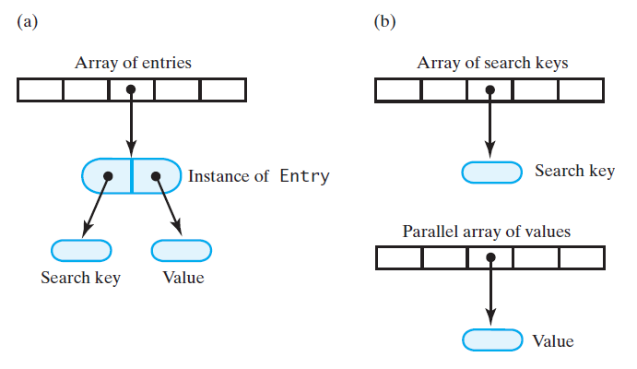
Array-Based Implementations
    We will focus on approach (a)
Figure 20-1 Two possible ways to use arrays to represent the entries in a dictionary:
an array of objects that encapsulate each search key and corresponding value;
parallel arrays of search keys and values

Slide 25
Array-Based Implementations
We will implement an array of objects as shown in Figure 20-1a
View Listing 20-1
  Class ArrayDictionary
  Inner class Entry

Slide 26
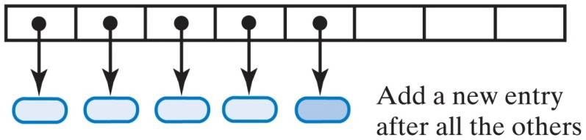
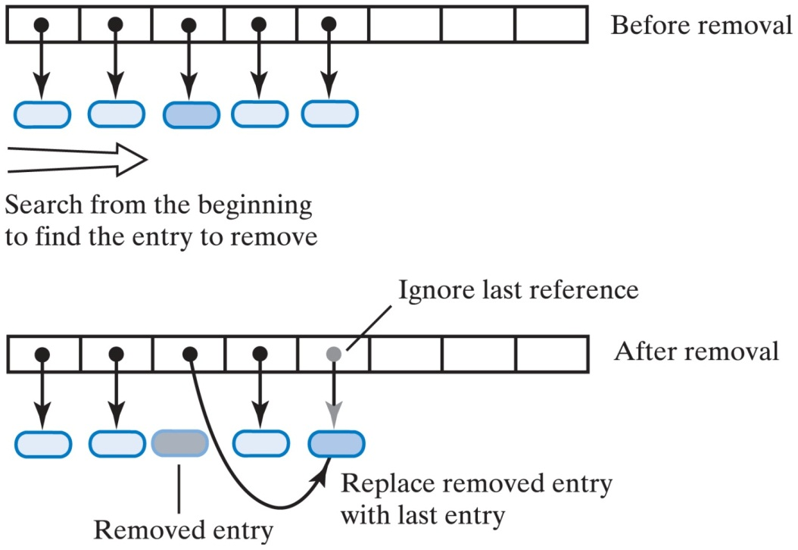
Unsorted Array-Based Dictionary
Adding a new entry to an unsorted array-based dictionary
  See add()
Removing an entry from an unsorted array-based dictionary
  See remove()

Slide 27
Array-Based Implementations
Worst case efficiencies
  Addition O(n)
  Removal O(n)
  Retrieval O(n)
  Traversal O(n)
At same time realize overhead required for occasionally enlarging array

Slide 28
A Sorted Array-Based Dictionary
Search keys must belong to a class that implements the interface Comparable
Some of implementation for unsorted dictionary can still be used
View outline of class, Listing 20-2

Slide 29
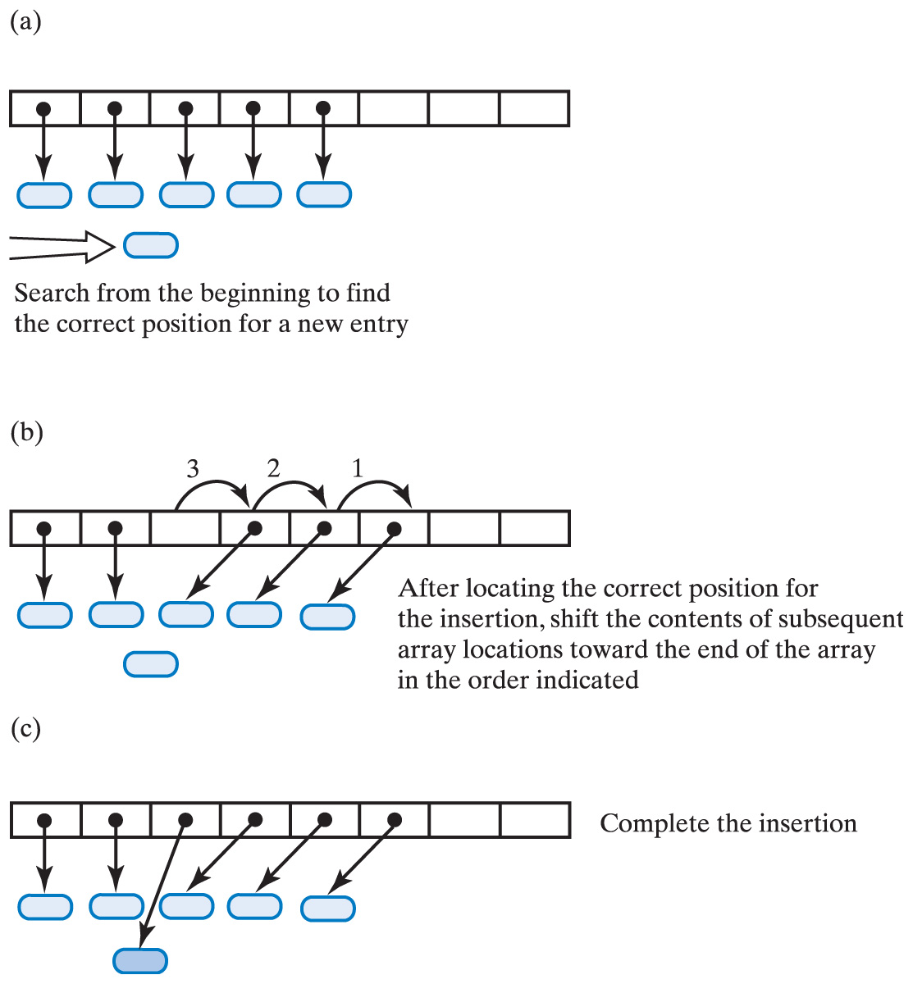
Sorted Array-Based Dictionary
Adding an entry to a sorted array-based
dictionary:
  search
  make room
  insert

Slide 30
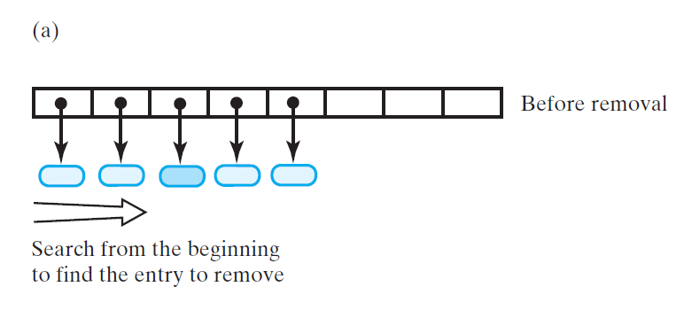
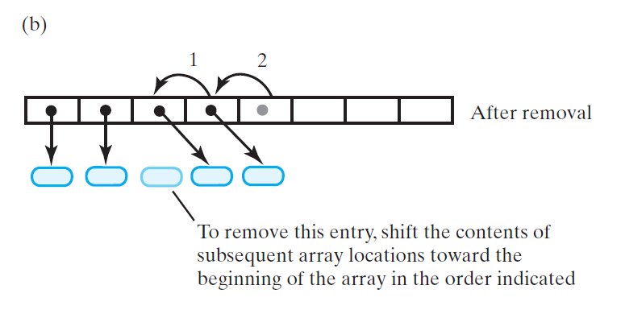
Removing an entry from a sorted array-based dictionary:
(a) search;
(b) shift entries

Slide 31
A Sorted Array-Based Dictionary
Worst-case efficiencies when locateIndex uses a binary search,
  Addition O(n)
  Removal O(n)
  Retrieval O(log n)
  Traversal O(n)

Slide 32
Linked Implementations
Chain of linked nodes
Chain can provide as much storage as necessary
Encapsulate the two parts of an entry into an object

Slide 33
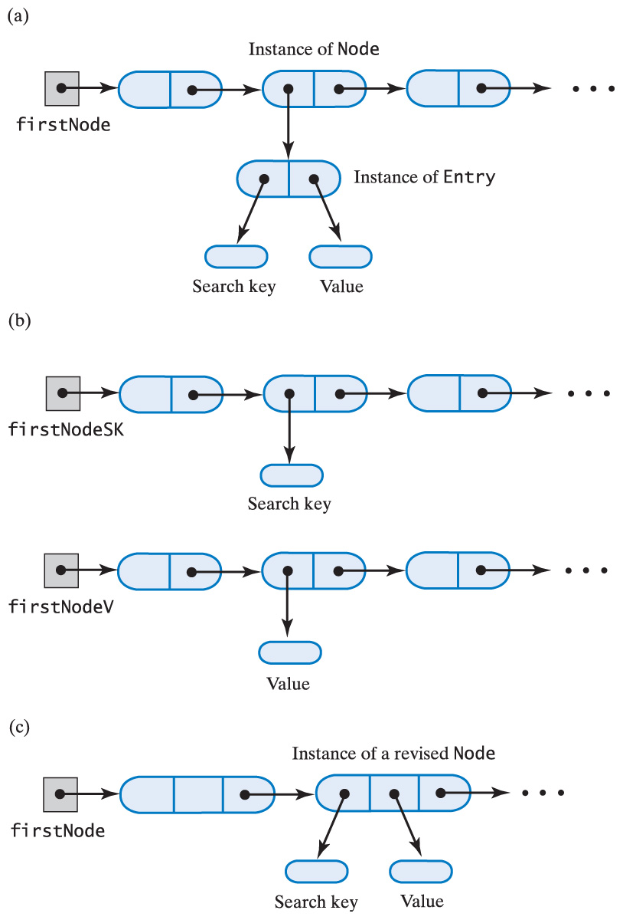
Linked Implementations
Three possible ways to use linked nodes to represent the entries of a dictionary:
  a chain of nodes that each reference an entry object
  parallel chains of search keys and values
  a chain of nodes that each references a search key and a value
    We will focus on approach (c)

Slide 34
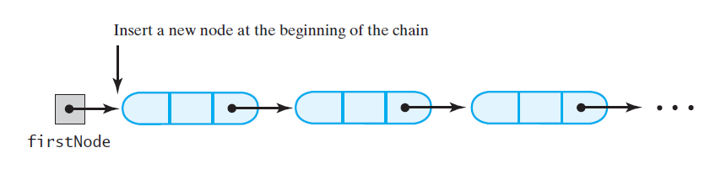
An Unsorted Linked Dictionary
For this implementation, worst-case efficiencies of operations
  Addition O(n)
  Removal O(n)
  Retrieval O(n)
  Traversal O(n)

Slide 35
A Sorted Linked Dictionary
Adding a new entry requires sequential search of chain
  Do not have to look at the entire chain, only until pass node where it should have been
Listing 20-3, class SortedLinkedDictionary
Note private inner class for iterator, Listing 20-4
Worst case efficiencies of dictionary operations for sorted linked implementation
  Addition O(n)
  Removal O(n)
  Retrieval O(n)
  Traversal O(n)

